Slide 1


Employee Database management
.

Slide 2


CONTENTS
Introduction
Problem Statement
Flowchart
Problem Definition
Conclusion

Slide 3
INTRODUCTION
Most of the contemporary Information systems are based on the Database technology as a collection of logically related data, and DBMS as a software system allowing the users to define, create, maintain and control access to the database.
The process involves a mutual development of application program and database.
The application program is actually the bridge between the users and the database, where the data is stored.
The so defined systems differentiate to each other and their development comprises a great variety of tasks to be resolved and implemented.

Slide 4
PROBLEM STATEMENT
This report’s documentation goes through the whole process of both application program and database development. It also comprises the development tools have been utilized for these purposes.
The program should perform the basic operations upon the database as retrieving, inserting, updating and deleting data. Any additional functionality is a goal of a further module development.

Slide 5
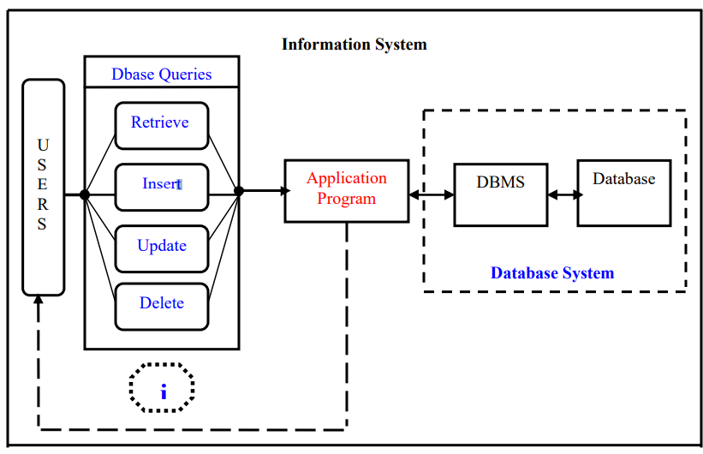
FLOWCHART

Slide 6
PROBLEM DEFINITION
Exploring the available development environments and techniques
Database Analyzing
Database design and Implementation
Program’s Structure Analyzing
Constructing a web page using HTML and Connecting database through PHP
Bringing all the stuff together
Tests

Slide 7
CONCLUSION
Employee database management was emphasized on the basic steps, consequently taken during the project’s development course as a particular attention was turned to the basic operative functions performed upon the data into the database.
The role of such systems is basic and essential within each company that wants to keep a really good control and record concerning its personnel data, functionality and performance on all levels in its structure.

